Slide 1
EMPLOYEE DATA ANALYSIS
STUDENT NAME : KARTHIKEYAN V
ROLL NO : D22AF031
REGISTER NO : 312215379
DEPARTMENT : ACCOUNTING & FINANCE
INSTITUTION : PATRICIAN COLLEGE OF ARTS & SCIENCE

Slide 2
PROJECT TITLE
EMPLOYEE DATA ANALYSIS USING EXCEL

Slide 3
AGENDA
PROBLEM STATEMENT
PROJECT OVERVIEW
END USERS
OUR SOLUTION AND PROPOSITION
DATASET DESCRIPTION
WOW IN OUR SOLUTION
MODELLING
RESULTS
CONCLUSION

Slide 4
PROBLEM STATEMENT
I WANT TO KNOW ABOUT THE DIFFERENCE BETWEEN MALE EMPLOYEES AND FEMALE EMPLOYEES IN AN ORGANIZATION AND ALSO TO KNOW ABOUT WHICH CITY THE EMPLOYEES BELONG TO. HENCE THE PROJECT IS BEING CONDUCTED.

Slide 5
PROJECT OVERVIEW
THIS PROJECT IS BEING MADE TO FIND OUT THE DIFFERENCE BETWEEN THE NUMBER OF MALE AND FEMALE EMPLOYEES AND ALSO TO FIND THE DIFFERENT CITIES FROM WHICH THE EMPLOYEES ARE FROM WITH THE HELP OF MS EXCEL AND ITS VARIOUS FUNCTIONS.

Slide 6

WHO ARE THE END USERS?
(This Photo by an Unknown Author is licensed under CC BY-NC)

Slide 7
OUR SOLUTION AND ITS VALUE PROPOSITION
TO SOLVE MY PROBLEM, I HAVE COLLECTED DATA SETS OF EMPLOYEES WITH INFORMATION REGARDING GENDER, LEAVE OUT, BENCHED OUT, CITY AND I WILL BE USING VARIOUS FUNCTIONS OF MS EXCEL TO FIND OUT THE SOLUTION.

Slide 8
DATA SET DESCRIPTION
FEATURES OF DATA SET:
ID
GENDER
CITY
BENCHED OUT
LEAVE OUT
EXPERIENCE
(THE DATA SET HAS BEEN EXTRACTED FROM KAGGLE)

Slide 9
THE “WOW” FACTOR IN OUR SOLUTION
FUNCTIONS AND FORMULAS
DATA ANALYZING AND VISUALIZATION
ORGANIZING AND FORMATTING WORKSHEETS
SHORTCUT AND PRODUCTIVITY TIPS
SOLVING PROBLEMS AND CHALLENGES

Slide 10
MODELLING
A) MS EXCEL:
MICROSFT EXCEL ENABLES USERS TO FORMAT, ORGANIZE AND CALCULATE DATA IN SPREADSHEET.
B) SORTING FUNCTION:
SORTING HELPS TO ORGANIZE DATA. YOU CAN SORT A TEXT COLUMN IN ALPHABETICAL ORDER (A – Z OR Z – A ). WE CAN SORT A NUMERICAL FORM EITHER FROM THE LARGEST TO SMALLEST ORDER OR FROM THE SMALLEST TO LARGEST ORDER.

Slide 11
C) FILTER FUNCTION:
FILTER IS AN ESSENTIAL TOOL THAT HELPS TO DISPLAY RELEVANT DATA. IT ELIMINATES THE IRRELEVANT ENTRIES TEMPORARILY FROM THE VIEW.
D) KAGGLE:
KAGGLE IS A SUBSIDIARY OF GOOGLE. IT IS AN ONLINE COMMUNITY OF DATA SCIENTISTS AND MACHINE LEARNING ENGINEERS. IT ALLOWS USERS TO FIND DATASETS THEY WANT TO USE IN BUILDING AI MODELS, PUBLISH DATASETS, WORK WITH OTHER DATA SCIENTISTS AND MACHINE LEARNING ENGINEERS AND TO ENTER COMPETITIONS TO SOLVE DATA SCIENCE CHALLENGES.

Slide 12
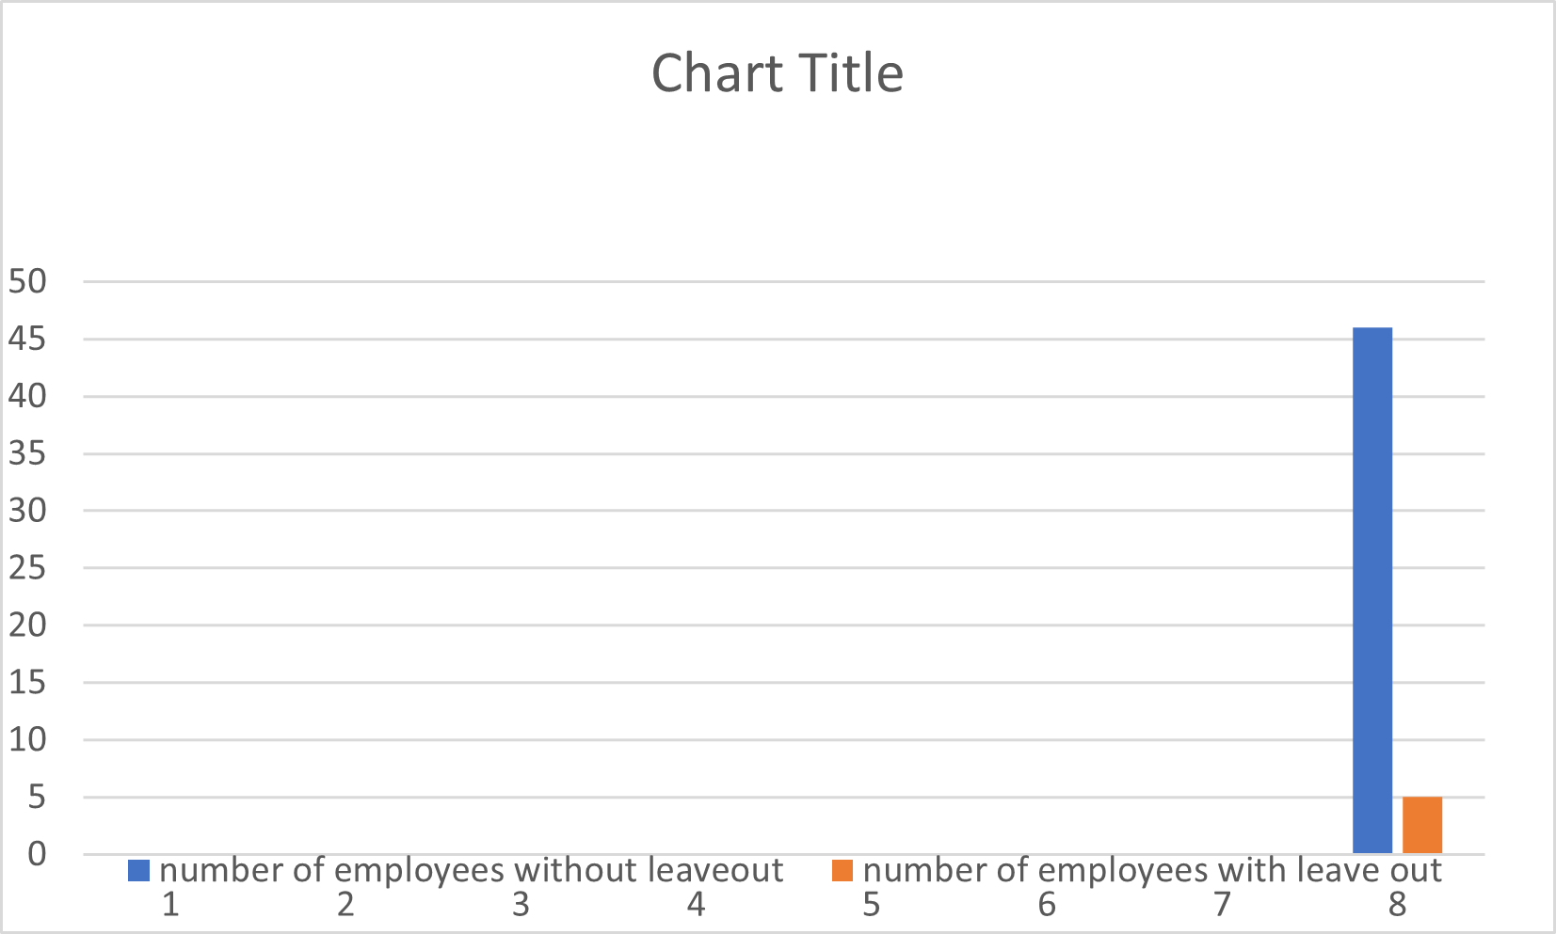
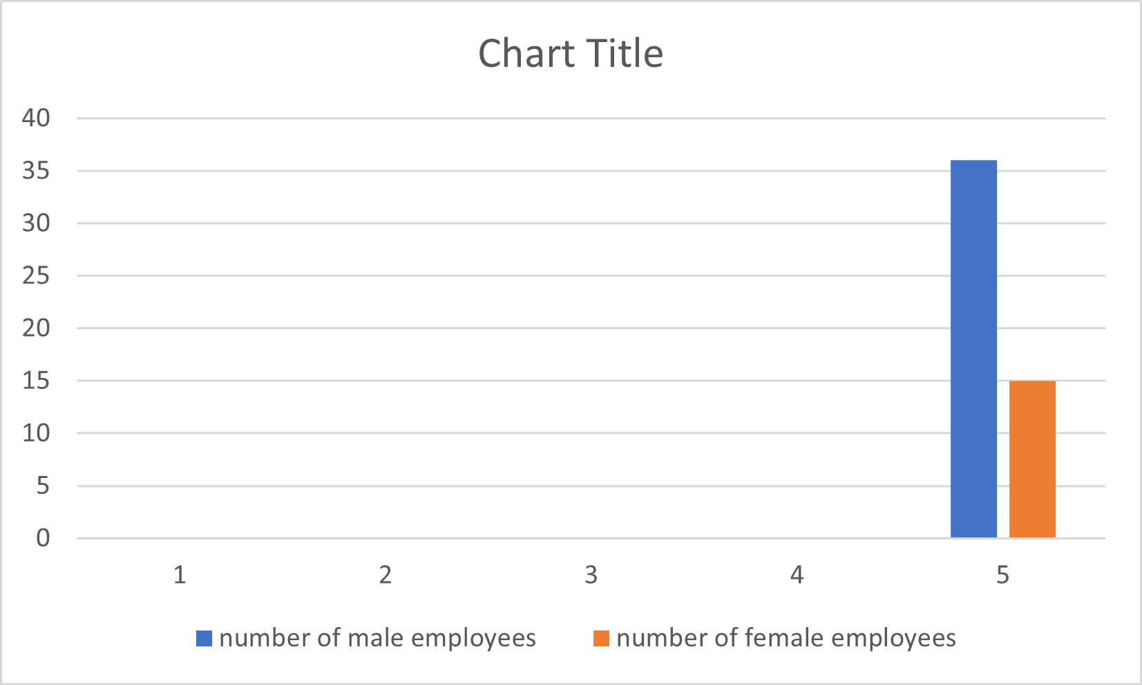
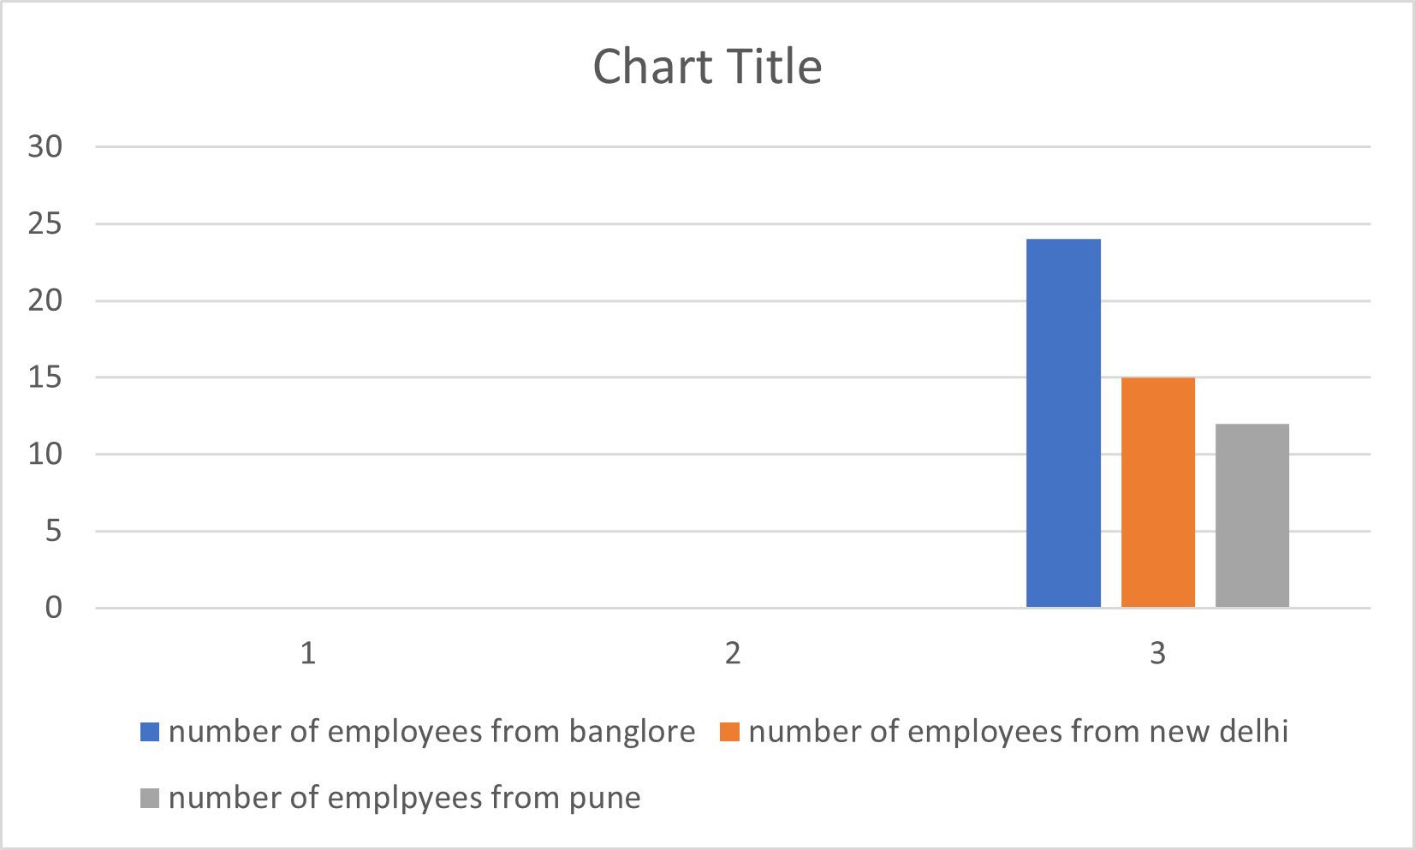
RESULTS

Slide 13
CONCLUSION
I HAVE FOUND OUT THAT THERE ARE MORE MALE EMPLOYEES COMPARED TO FEMALE EMPLOYEES. ONLY A SMALL AMOUNT OF EMPLOYEES WERE BENCHED OUT AND LEFT OUT. EMPLOYEES BELONG THREE DIFFERENT CITIES.

